Slide 1

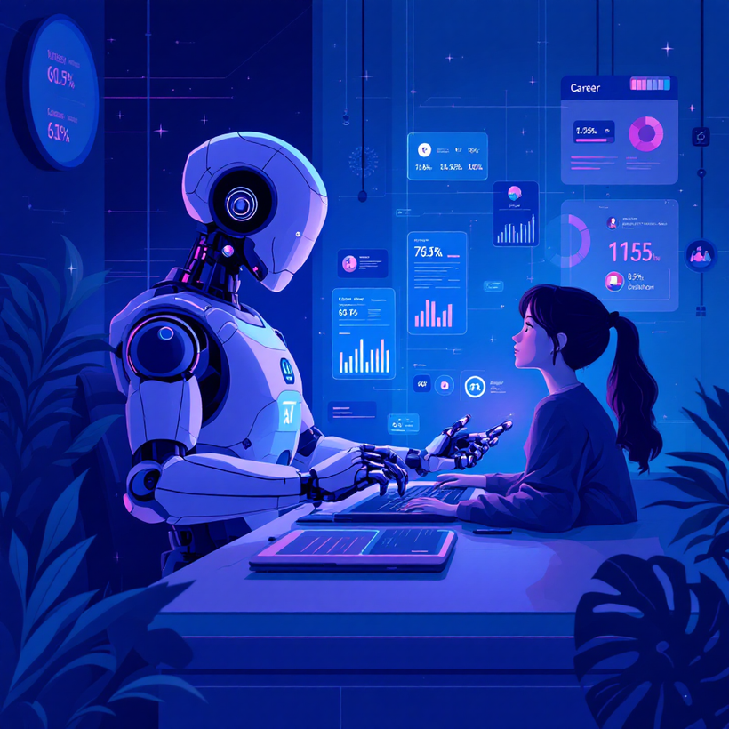
SMART CAREER APPLICATION ASSISTANT
PRESENTED BY:
MONIKA, PRIYANKA, SHRISHTI

Slide 2

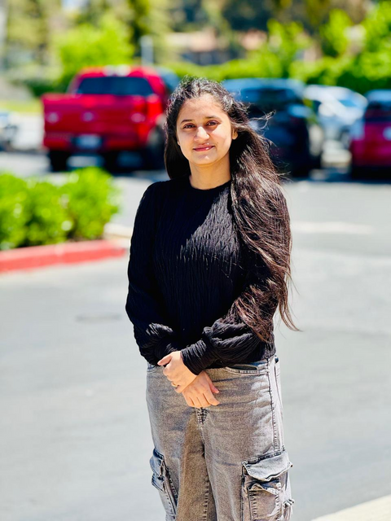
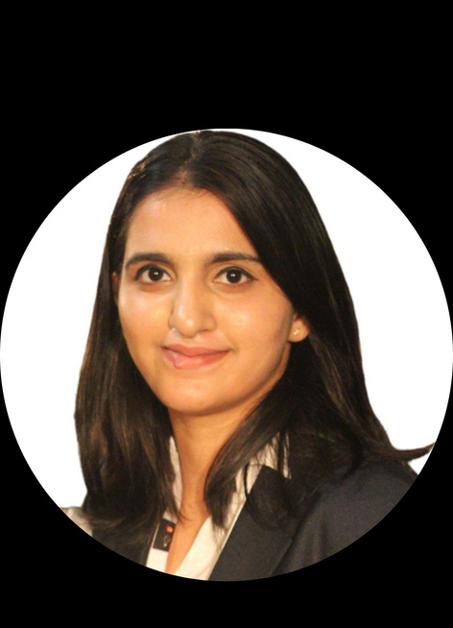
SCAA
MEET OUR TEAM
Monika Dhukia
Priyanka
Shrishti

Slide 3

❗PROBLEM STATEMENT
Job seekers struggle with understanding what skills matter for a role.
Resumes are often unclear, outdated, or poorly structured.
Students lack personalized career guidance.
Existing tools are generic and not tailored to individual profiles.

Slide 4

🤖 WHY USE AI AGENTS?
Agents automate reasoning and choose tools dynamically.
They can read resumes, extract skills, search the web, and generate answers.
Handles complex flows: search → analyze → summarize → recommend.
Provides personalized, context-aware career guidance.

Slide 5
🧠 SYSTEM ARCHITECTURE (HIGH-LEVEL)
User uploads resume or asks a question
Extract Skills (Python function)
RAG-style agent reasoning
Uses Google Gemini for LLM reasoning
Uses google_search tool for real-time market data
Final structured recommendations returned

Slide 6



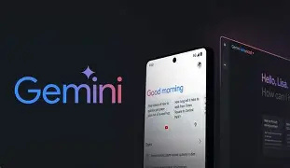

🛠️ TECHNOLOGIES USED
Python
Google ADK
Gemini 2.5 Flash Lite
google_search Tool
pdfplumber (PDF parsing)
Kaggle Notebook Environment

Slide 7
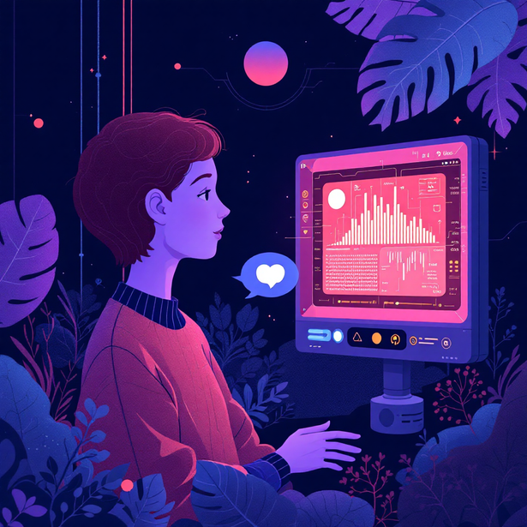
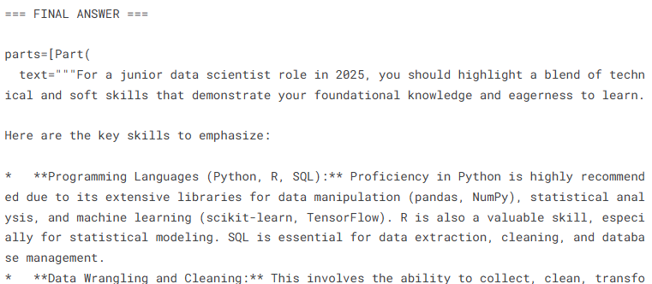
💬 DEMO — CAREER GUIDANCE Q &A
Ask: “What skills should I highlight for Data Scientist role?”
Agent uses google_search for 2025 trends
Returns actionable skill suggestions
Helps beginners understand real-time job market needs

Slide 8
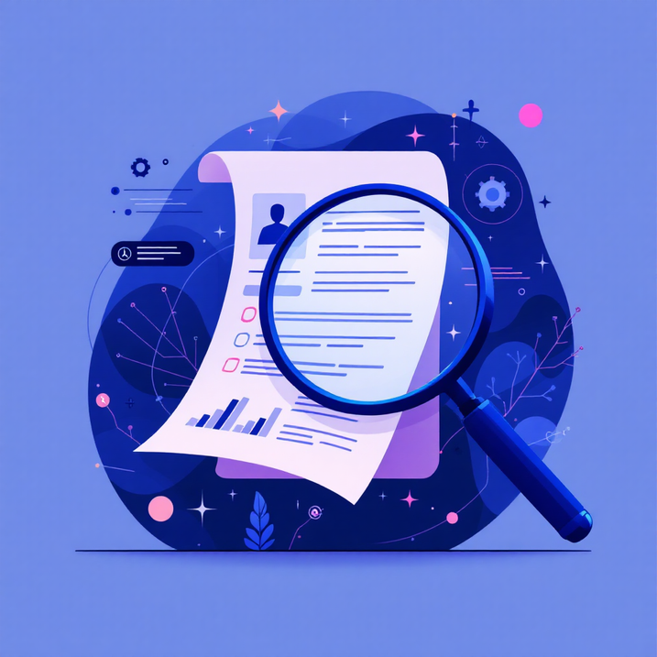
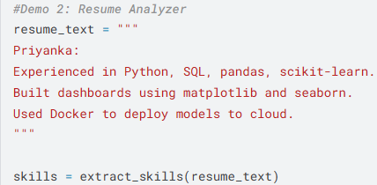
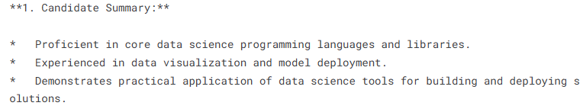
🎯 DEMO — RESUME ANALYZER
Upload a resume (.pdf)
Extract text with pdfplumber
Identify technical skills
Summarize profile
Suggest job roles
Provide resume improvements

Slide 9
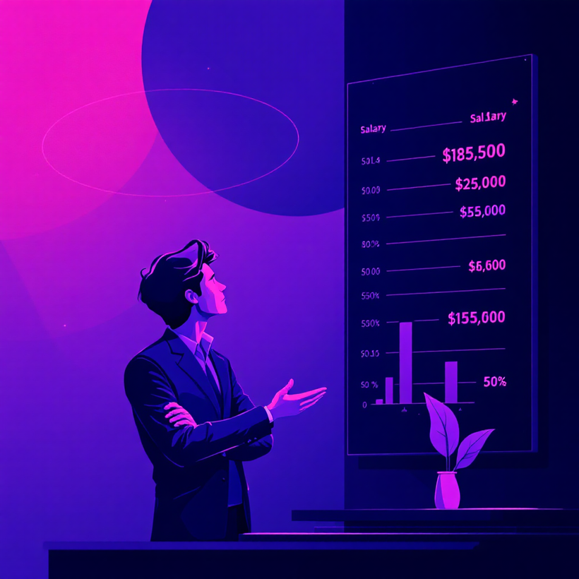
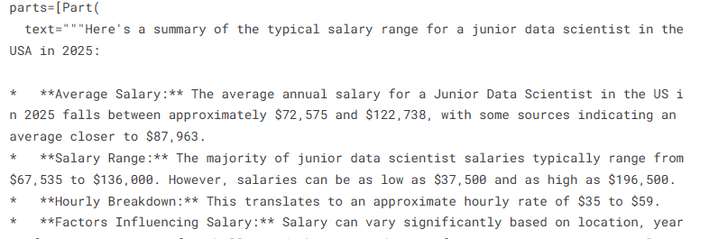
💰Demo — Salary Range Checker
Agent uses google_search
Fetches up-to-date salary data
Summarizes U.S. salary range
Helps candidates negotiate better

Slide 10
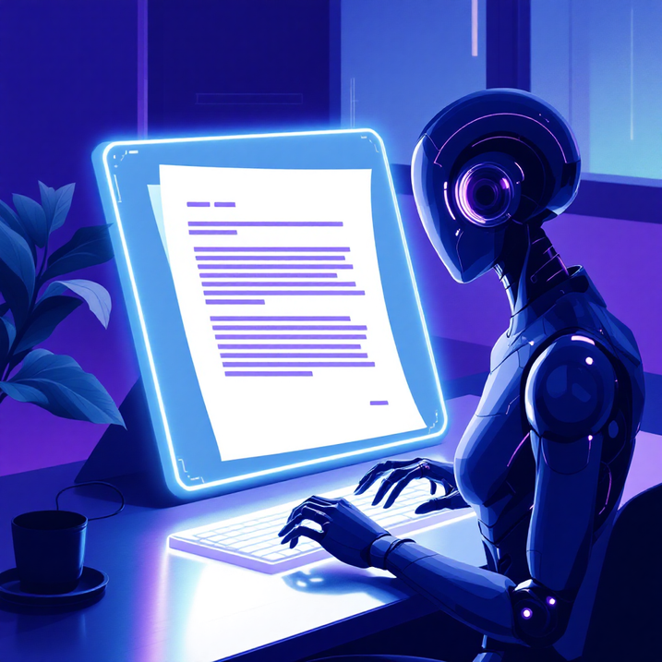
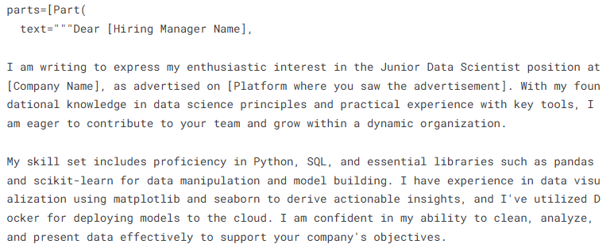
📝 DEMO — COVER LETTER GENERATOR
Reads resume
Builds a professional cover letter
Tailored to job role and skills

Slide 11
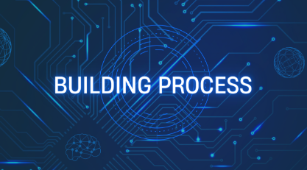
🧩 THE BUILD PROCESS
Defined skills extraction logic in Python
Configured ADK Agent + Gemini model
Added google_search tool
Created multi-step workflows
Wrapped everything inside Kaggle notebook
Tested with sample resumes

Slide 12
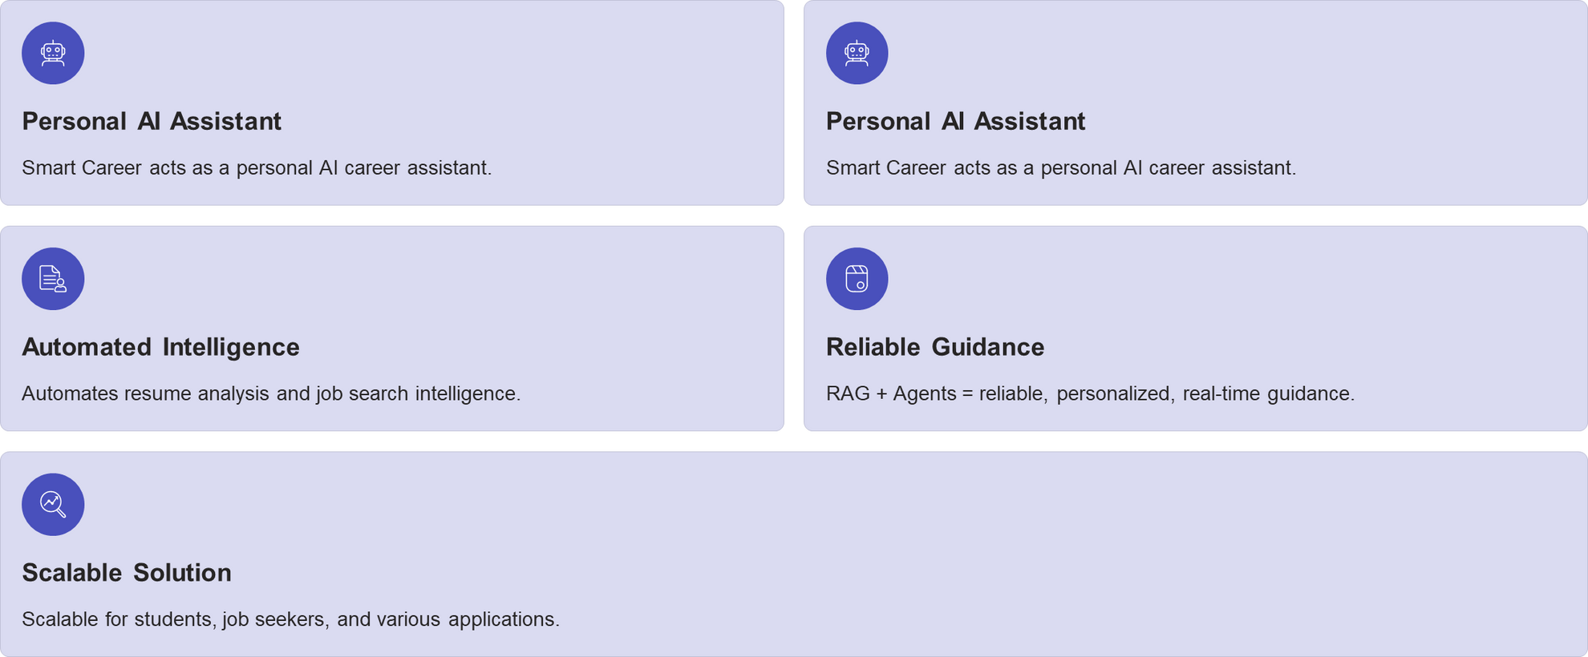
🚀 CONCLUSION

Slide 13
THANK
YOU

